Slide 1
Hyperjacking attacks
A tiny intro, what is it , and how to prevent it

Slide 2
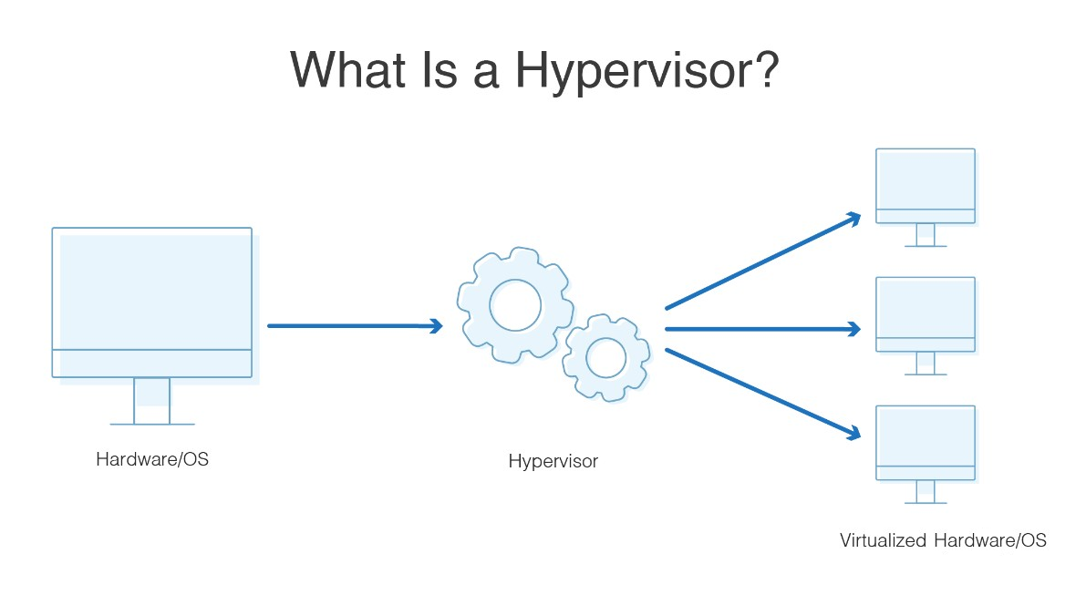
What is a hypervisor?
Hypervisor Is software that runs on a compute host that virtualizes it.
The compute host has 3 components
inside it which is: CPU, RAM, Network connection, and sometimes has forth component: storage.
simply, the compute host is a computer!
Cloud computing wouldn’t be possible without virtualization. Virtualization wouldn’t be possible without the hypervisor. This thin layer of software supports the entire cloud ecosystem.
Notes:
Reference : What is a Hypervisor?
https://www.youtube.com/watch?v=LMAEbB2a50M

Slide 3
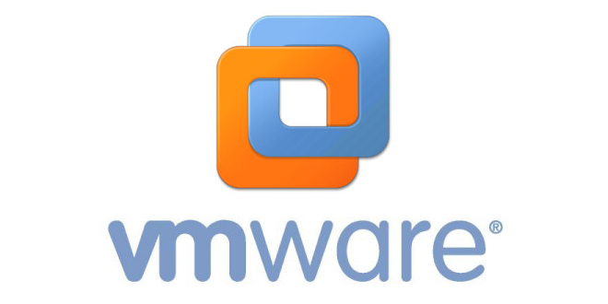
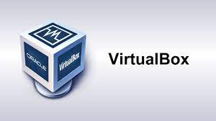
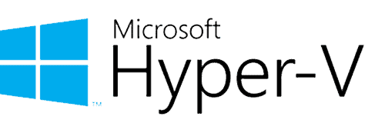
Hypervisor examples

Slide 4
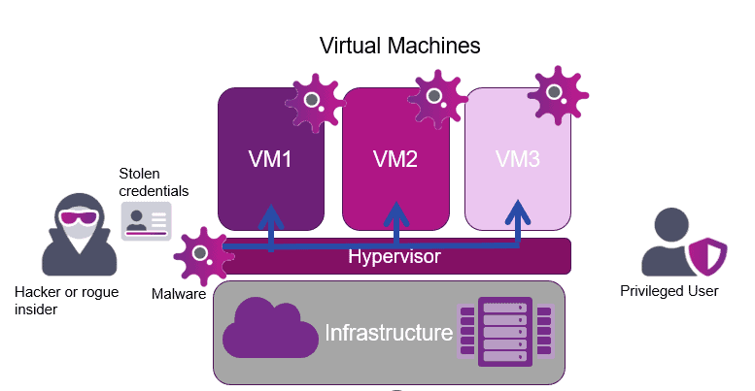
What is hyperjacking attack?
Hyperjacking is an attack in which attackers gain control over the hypervisor of a server or install a malicious hypervisor and exploit that to run malicious programs and applications on the virtual machines (VMs) that run on top of the hypervisor.
Hyperjacking involves an attacker taking control of the hypervisor, thereby taking command and control of the virtual machines
Notes:
Reference: https://www.thesecuritybuddy.com/data-breaches-prevention/what-is-hyperjacking-and-how-to-prevent-it/
Reference: https://www.entrust.com/blog/2022/11/preventing-hyperjacking-in-a-virtual-environment/

Slide 5
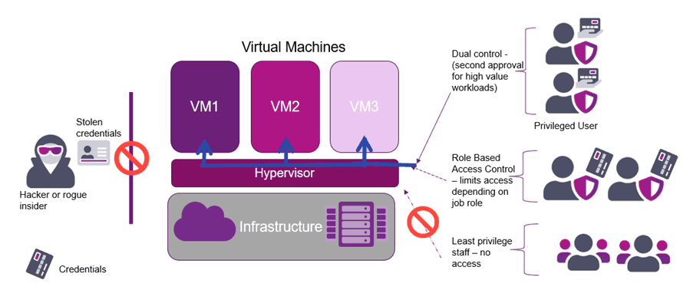
How to prevent hyperjacking attacks?
Role-Based Access Controls by least-privilege model
a strong password policy
the use of multi-factor authentication

Slide 6
Role-Based Access Controls
In another meaning: authentication, which controls the integrity of authorizations, so in this case any action done on any virtual machine will be putted in the log file and tagged with a specific username.
a strong password policy
Simply force the VM users to put a strong password.
multi-factor authentication
Any important and secure actions (link login, change any critical configurations in vm) should be done after multi-factor authentication (link sms OTP, email OTP, …etc)

